Slide 1

Every effort is made to supply correct and current information, facts are checked often!
One doctor may have a different way of doing things from another. I am simply presenting my views on how to workup common practices to utilize in your office.
The codes are owned and licensed for use in my programs.
Both the AMA and ADA have contracts with Links 2 Success/Dental Medical Billing allowing the use of codes in my courses.
By participating in this presentation, you agree not to use this presentation as medical advice to treat any medical condition in either yourself or others, including but not limited to patients that you are treating.
I welcome any comments or suggestions.
Navigating that Expand Your Horizons
Billing and Coding
Christine Taxin Adjunct Professor

Slide 2


You are the new agent in the office!
Christine Taxin Adjunct Professor

Slide 3
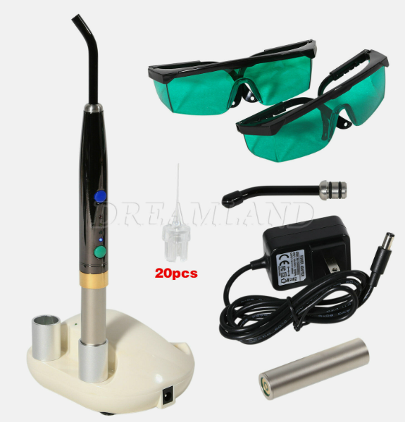
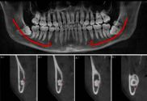
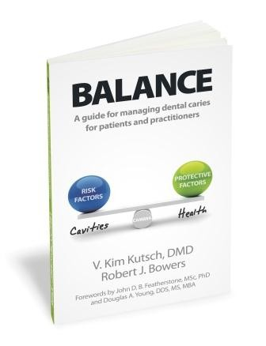
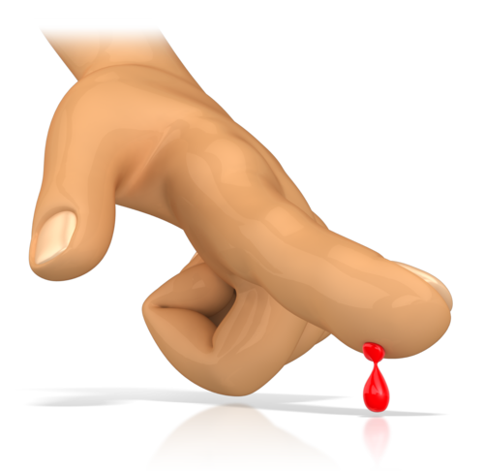

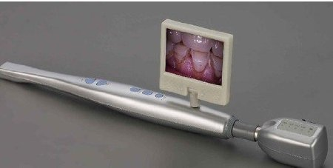

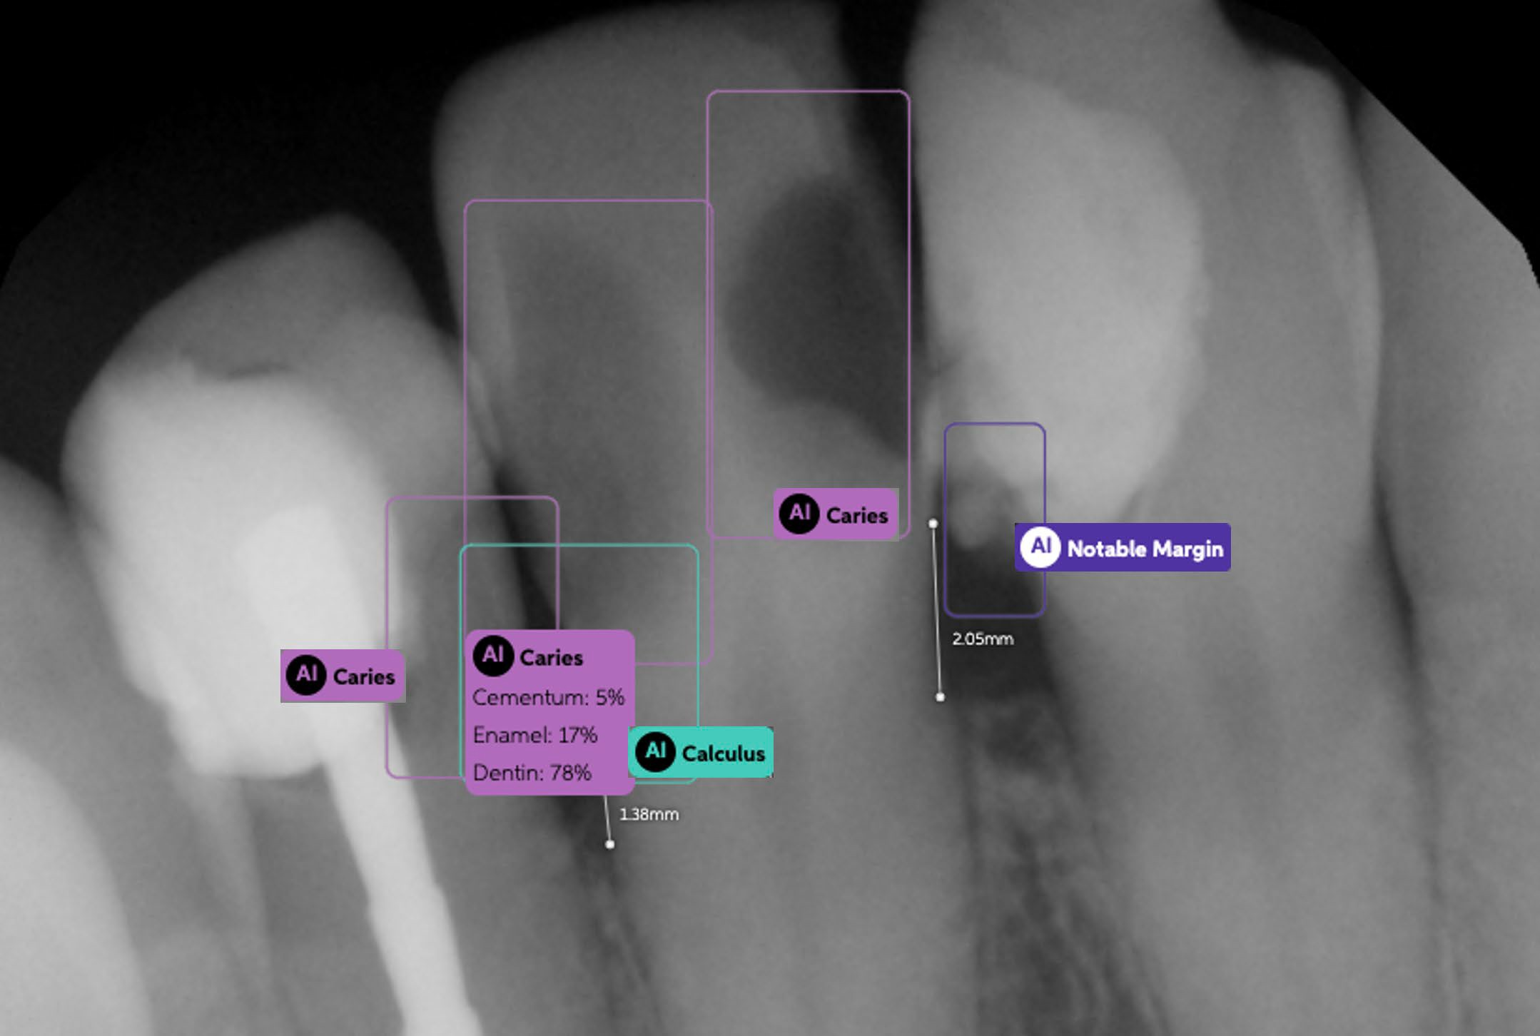
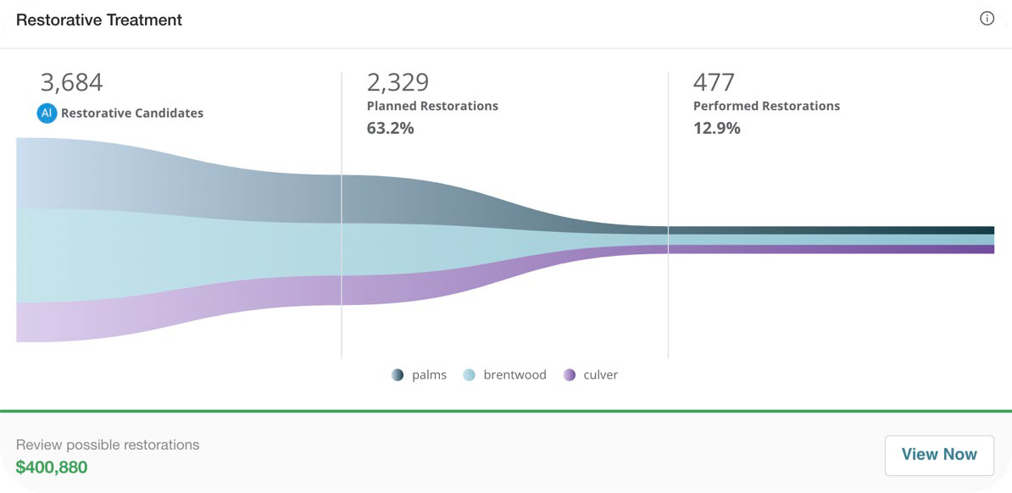


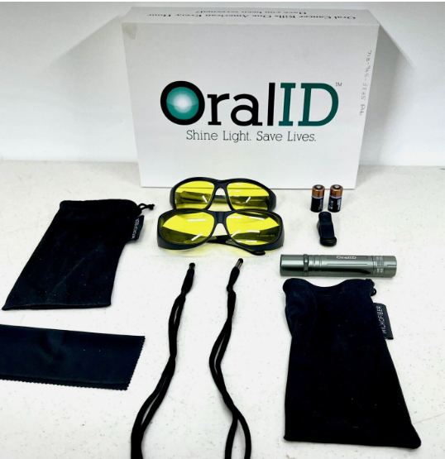
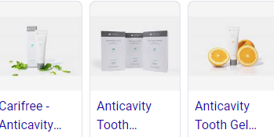
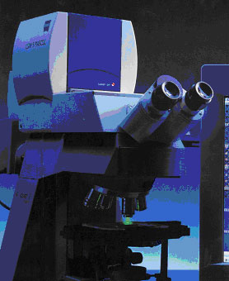


What Tools are in your Diagnostic Box?

Slide 4

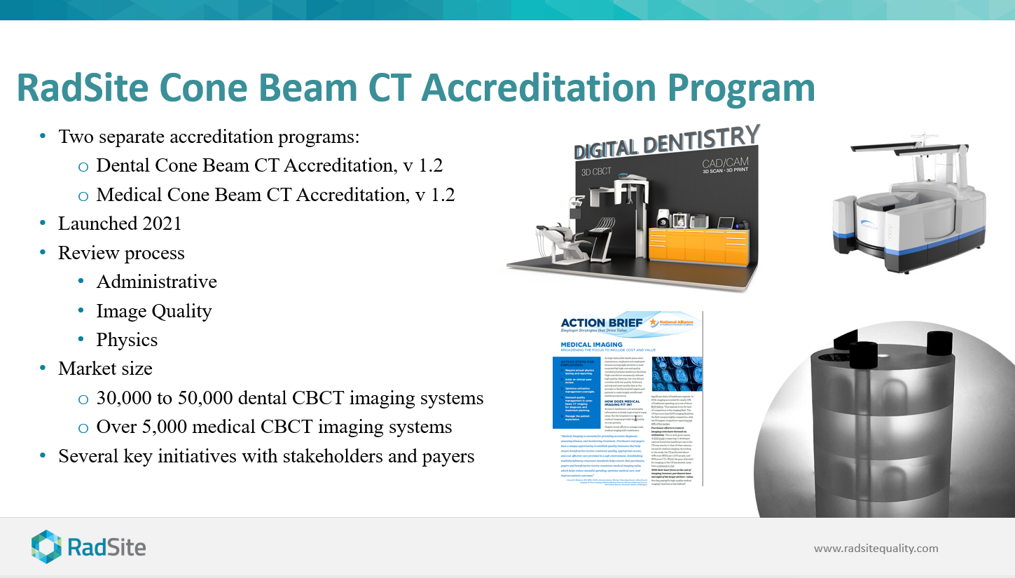

Notes:
Eliot and Phil

Slide 5
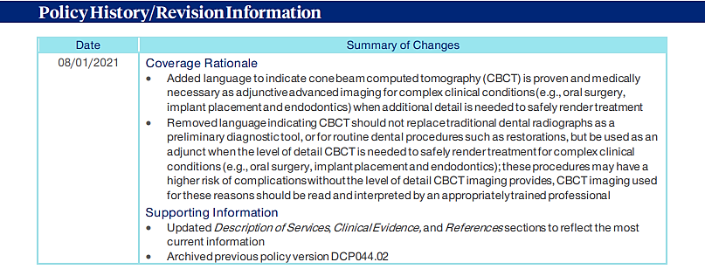
United Health Care Policy

Slide 6
A CBCT Scan, also known as a cone beam computerized tomography, is an x-ray technique that produces 3D (3 dimensional) images of your skull, allowing for visualization of internal body bony structures in cross section (rather than as overlapping images typically produced by conventional x- ray exams). CBCT scans are primarily used to visualize bony structures, such as teeth and your jaws, and not for soft tissues such as your tongue or gums.
Advantages of CBCT Scan over conventional x-rays:
A conventional x-ray of your mouth limits your dentist to a two-dimensional or 2D visualization. Diagnosis and treatment planning can require a more complete understanding of complex three-dimensional or 3D anatomy. CBCT examinations provide a wealth of 3D information which may be used wen planning for dental implants, surgical extractions, maxillofacial surgery, and advanced dental restorative procedures.
Benefits of CBCT Scan include:
Visualization of vital structures such as nerves and sinus cavities. Higher accuracy in determining bone volume and bone density when planning implant surgery. Greater chance for diagnosis condition such as vertical root fractures that can be missed on conventional x-ray films. Greater chance of providing images and information which may result in the patient avoiding unnecessary dental treatment. The CBCT scan enhances your dentist's ability to see what needs to be done before your treatment is started.
Radiation:
CBCT scans, like conventional x-rays, expose you to radiation. The amount of radiation used for CBCT examinations is carefully controlled to ensure the smallest possible amount is used that will still give a useful result. The dosage per scan is equivalent to 2 regular dental x-rays: however, all radiation exposure is linked with a slightly higher risk of developing cancer. The advantages of the CBCT scan outweigh this disadvantage.
Pregnancy:
Women who are pregnant should not undergo a CBCT scan due to the potential exposure to the fetus. Please tell your doctor if you are pregnant or planning to become pregnant.
Diagnosis of non-dental conditions:
While parts of your anatomy beyond your mouth and jaw may be visualized in the scan, your doctor may not be qualified to diagnose conditions that may be present in the head and neck beyond the dental zone. A CBCT may show evidence of disease of the cervical spine, skull or arteries. An oral maxillofacial radiologist will review your scan to identify any abnormalities, asymmetries, or pathological conditions noted upon the CBCT scan.
Educate your
Patients!

Slide 7
Tele-dentistry
Uses virtual communication technology to provide patients with dental care. – Advice for non-emergency dental issues: • Oral pain and swollen gums • Broken, chipped or sensitive teeth • Sores, lesions, swelling or infections • Clinically appropriate, non-DEA controlled prescriptions when needed • Second opinions for oral health diagnoses and treatment options
A great tool to use when hiring a virtual assistant to make appointments, verify benefits, and have all the forms filled out.
This can be done by a virtual assistant, who daily answers the phone and uses tele-dentistry to work with patients as if she was in the office.
No interruptions, and a personal touch who can also make sure every paper is filled out, and the doctor can see them before the patient comes to the office.

Slide 8


SOAP starts on the first phone call.
Your phone is the subject information from the patient. All of it must be documented by law.
Subjective information for best documentation includes the following prior to patient visit:
  Any issues they are having at the time of call, regarding pain, swelling or other issues.
  Did they get referred to office and by whom. List that person in the computer as referral
  Ask them to fax over the front and back of both insurance plans.
  Have them fill out all medical history with the name and phone of their medical doctor. Remind them you will be collaborating on health care.
  Ask them to sign Hippa form and add two signatures allowing office to speak to medical provider and medical insurance if needed.
  If they do not want to refill out a form, you must be firm reminding them that you will need this at the start of every treatment since we are working under guidelines that help prevent transmission and avoid issues.
34
WWW.DENTALMEDICALBILLING.COM
CTAXIN@LINKS2SUCCESS.BIZ 914-

Slide 9
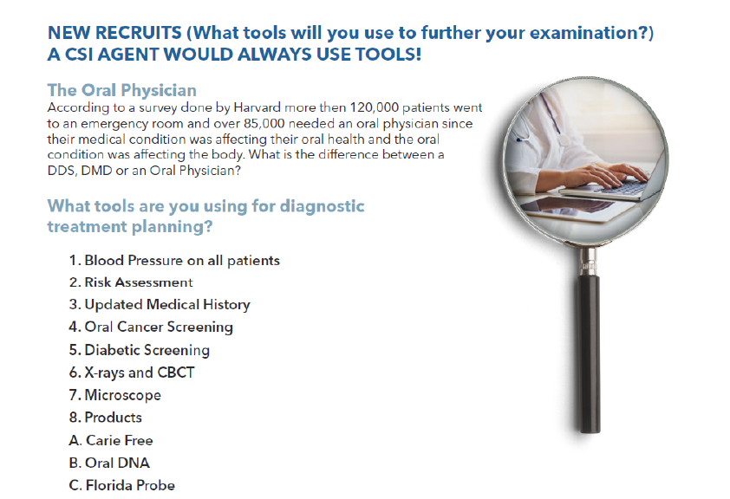
How are you diagnosing your patients?

Slide 10
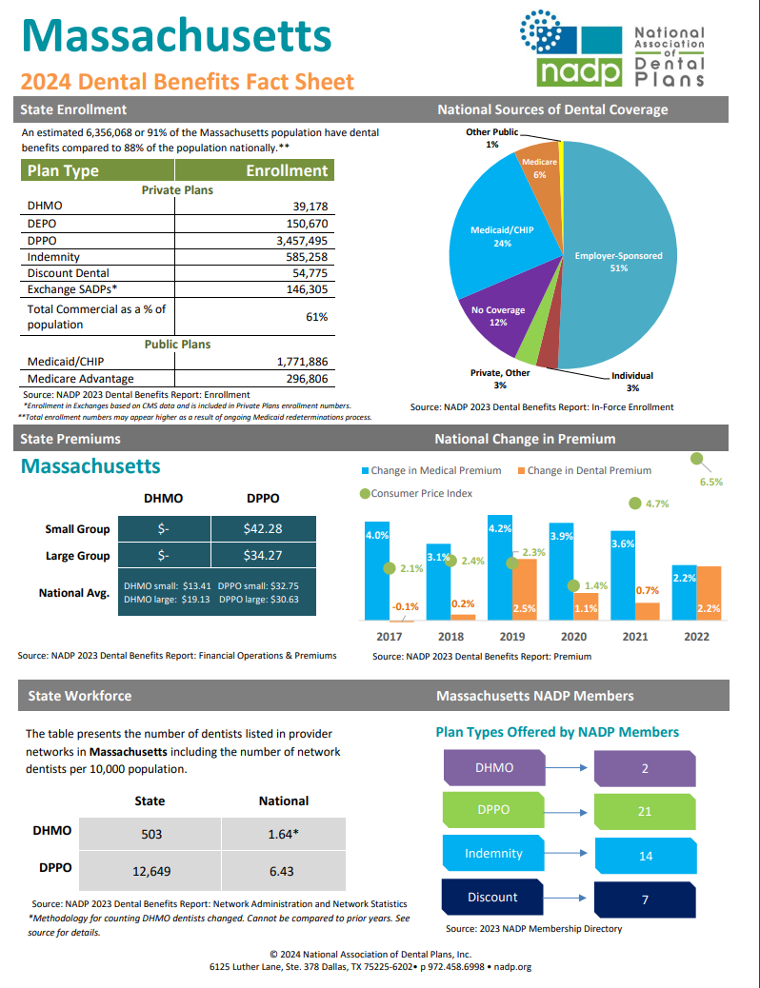
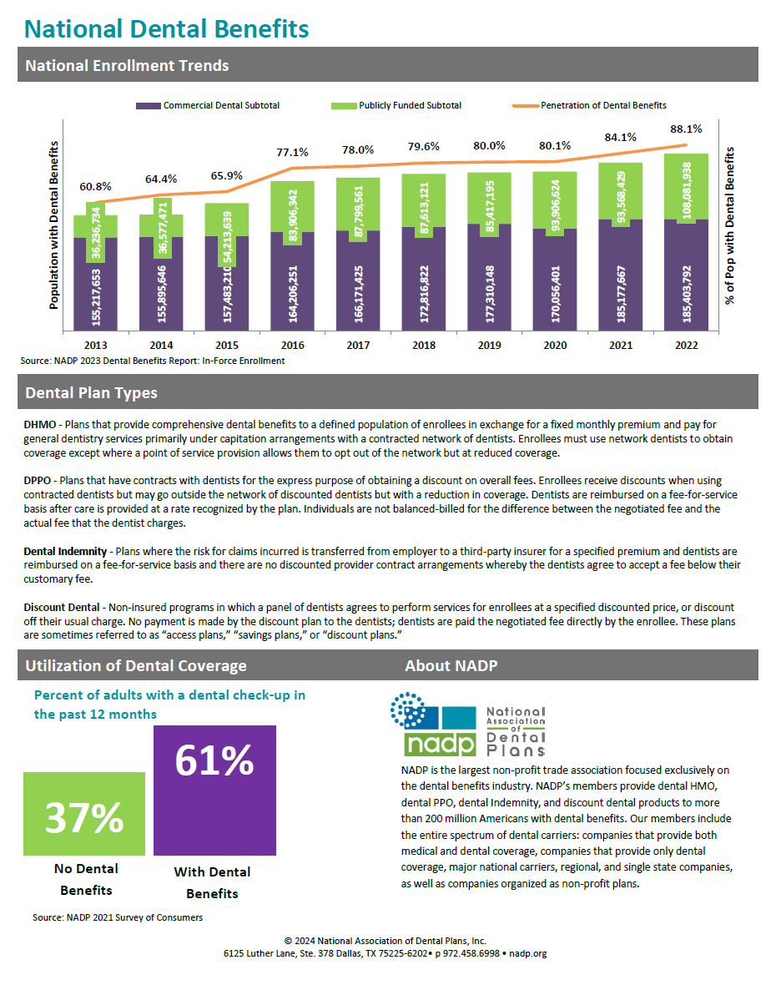

Slide 11







BoomCloud allows you to GROW and MANAGE and in-house membership program.
Reducing your dependance on PPO’s, Saving your staff time, and improving patient experience
PPO Patients
Membership Patients
Patient spend average is $500/year
Membership Patient spend $2,350 a year!
PPO (or cash only) patient loyalty is 64%
Patient loyalty is 94%!

Slide 12
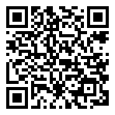


Case Studies
  7 to 7 Dental
TEXAS
9 locations & ~350 Members per loc
$2M Annual Recurring Revenue
  Desert Ridge Pediatric
Arizona
28 to 356 Members
in 2 Years
$156K Annual Recurring Revenue

Slide 13
Dental medical claims require ICD-10 codes
Dental medical claims require ICD-10 codes - Horizon Dental (horizonblue.com)
Your role as an active practitioner in your patients’ dental care is vital to their overall health. In an effort to better care for your patients, our members, we require that you provide ICD-10 codes when submitting claims to us. ICD-10 codes capture more detailed health care data to help improve patient care and outcomes.
You should review your patients’ overall health with them at every visit and document the appropriate ICD-10 codes for any health conditions and medications that are important to the care you provide.
How to submit ICD 10 codes with claims
The American Dental Association (ADA) has included a section on the 2012/2019 revised claim form for ICD-10 codes.
Please submit appropriate ICD-10 codes in section 34a of the 2012/2019 ADA claim form as a routine part of submitting your claim to us.
Use any and all ICD-10 codes within the following categories:
Alcohol use complications: 099.33
Cardiovascular disease; screening for disease or disorder: Z13.9
Chronic kidney disease: N18.9
Diabetes: E08-E13
Drug use complicating pregnancy: F11-F16
Maternity/pregnancy
Pregnancy diabetes: 024.9
Vomiting: 021.8

Slide 14
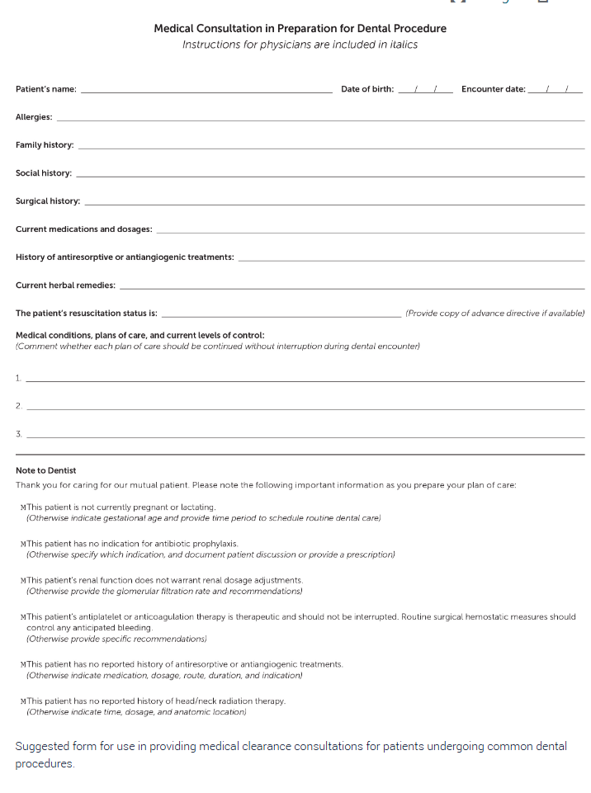
Oral health directly affects overall health and quality of life. More Americans lack dental insurance than medical insurance. Patients with poor oral health are more likely to have respiratory and cardiovascular diseases, adverse pregnancy outcomes, and diabetes mellitus. Early childhood caries is the most common chronic condition in American children. Certain illicit and prescription drugs increase the risk of enamel erosion and caries formation in adults. Incision and drainage is the treatment of choice for dental abscess. Risk factors for periodontal disease include smoking, diabetes, human immunodeficiency virus infection, use of certain medications, and genetic susceptibility. Patients with gingivitis typically present with swollen, erythematous gum tissue that bleeds easily with brushing or flossing. One in three children will have an injury to the primary teeth, and one in five 12-year-old children will have an injury to the permanent teeth. All dental fractures should be evaluated with imaging and managed in conjunction with a dental professional. Immediate reimplantation is the preferred treatment for avulsed permanent teeth. Primary care clinicians are well positioned to reduce rates of oral disease. Family physicians can incorporate oral health into routine practice through counseling about diet, oral hygiene, smoking cessation, and fluoride supplementation; application of fluoride varnish; and screening for dental disease.
Dental Problems in Primary Care | AAFP

Slide 15
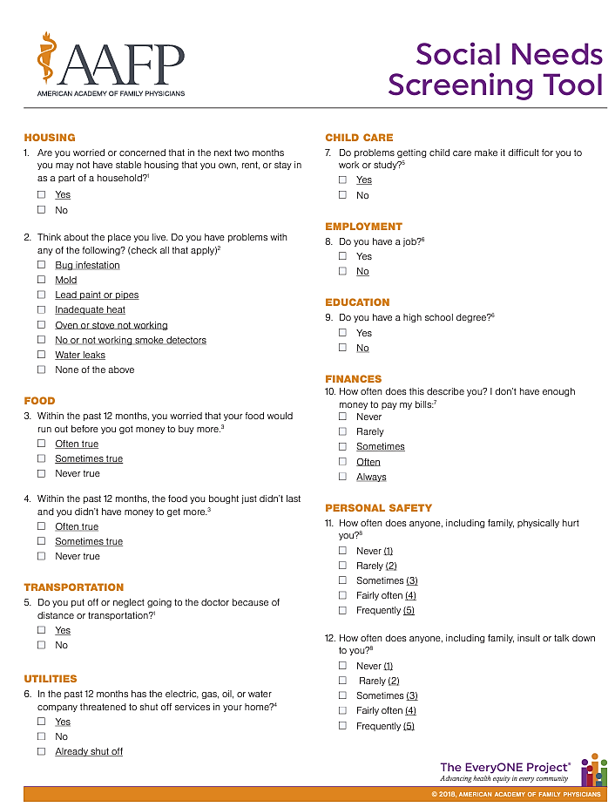
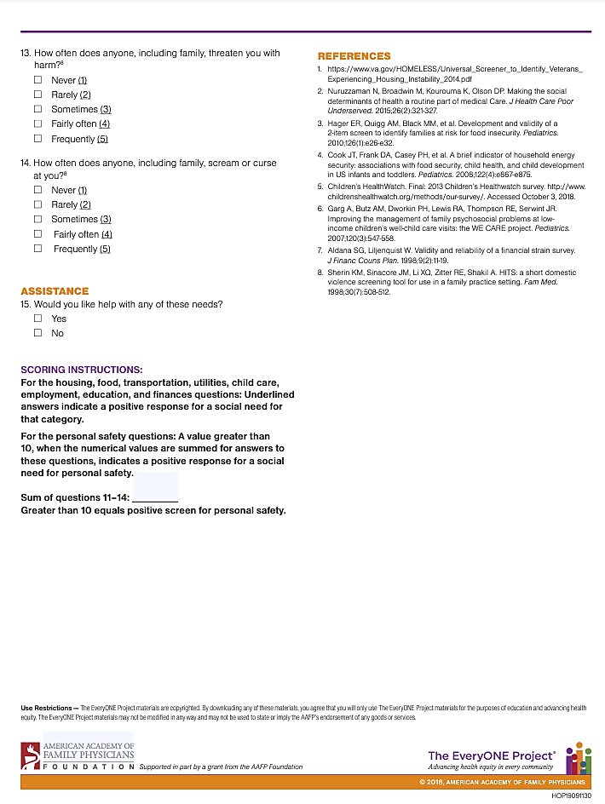

Slide 16

1. Healthcare Access and Quality
This category addresses the relationship between people’s access to and understanding health services and their own health. SDOH include access to healthcare, health insurance coverage, and health literacy.
Most of these SDOH can be found in ICD-10-CM categories Z55 and Z56, and code Z91.120.
2. Education Access and Quality
This category incorporates the relationship between education and health. Key SDOH include obtaining a high school diploma or higher education, childhood education, and development.
See categories Z55 and Z62.
3. Social and Community Context
This category considers the context within which people live, learn, work, and play. Examples are cohesion within a community, civic participation, discrimination, issues in the workplace, and incarceration.
See categories Z57, Z60, and from Z60 to Z65.
4. Economic Stability
This category describes the connection between people’s financial resources, such as income and cost of living, and their health. Examples include poverty, employment, food security, and housing stability.
See categories Z56 and Z59.
5. Neighborhood and Built Environment
This category addresses the link between where a person lives — housing, neighborhood, and the environment — and their health. Examples include quality of housing, access to transportation, accessibility to healthy foods, water quality, and neighborhood violence.
See categories Z58 and Z59.

Slide 17
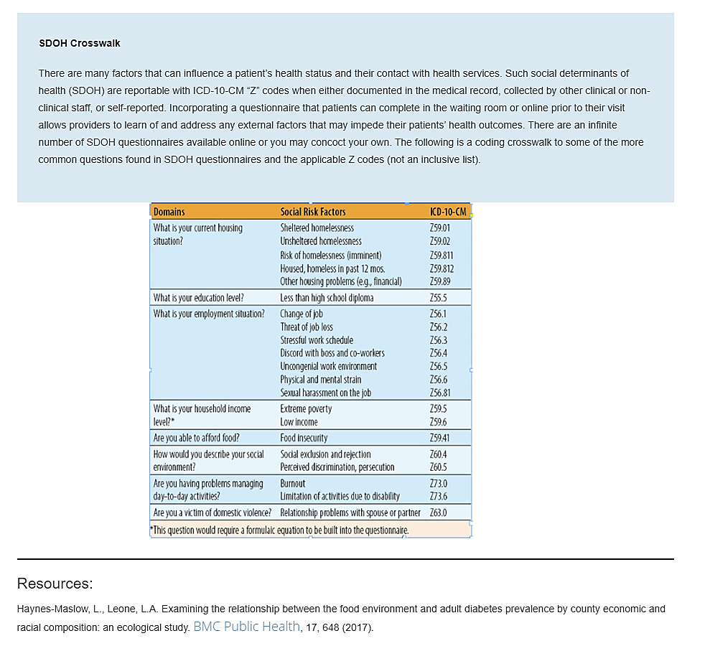

Slide 18
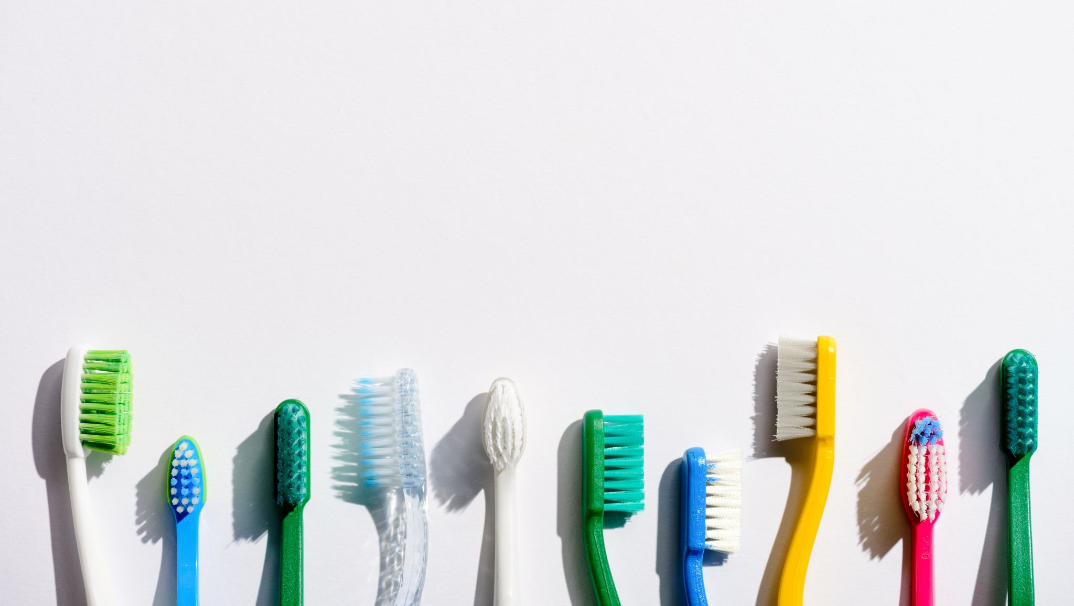
Diagnostic Codes in Dental
American Dental Association Has listed the most common diagnostic codes used in dentistry.
Becoming a CSI Detectives
A small Sample of codes are for Dental Encounters.
You will find that the you will need these when a medical provider refers patients to your office.
The are the following:
Z01.20 Encounter for dental examination and cleaning without abnormal findings.
Z01.21 Encounter for dental examination and cleaning with abnormal findings.
Z01.89 Encounter for specified special examinations
https://youtu.be/K8mu1JhjV30?t=12

Slide 19
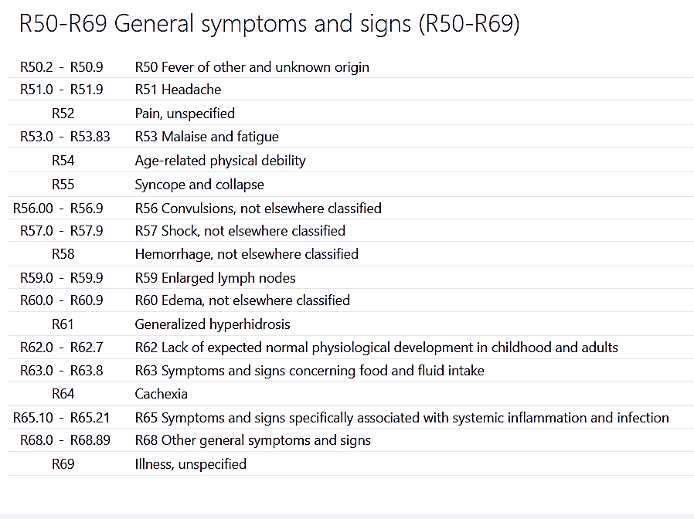
Use your diagnostic codes of symptoms and complains
Pre-Authorization will require signs and symptom codes if we have not done a full clinical examination and just go by what the patient describes and medical history.
Example from medical history submitted in advance gave us to large clues! Diabetes and Insulin, plus the mom told the office he has been in pain on the lower left, with swelling for 2 days and the pain level is 4. She has tried aspirin and rinsing with salt water and there is no improvement. Where would I look for those codes to get a pre-approval for a CBCT Scan?
Atypical facial pain (G50.1) elicits pain that may be sharp, but when more closely evaluated, is generally dull and lasting (constant).
It may present as aching, burning, crushing, sharp, or even very dull pain and is harder to diagnose, as it may be caused by an underlying medical condition
R52 - Pain, unspecifiedAcute pain NOS
Generalized pain NOS
Pain NOS
According to ICD-10-CM Guidelines Section II,H, Uncertain Diagnosis, correct coding would be to code the signs, symptoms, and abnormal clinical and lab findings using codes R00-R99 from Chapter 18. These are the only acceptable outpatient codes when a diagnosis has not been firmly established.

Slide 20
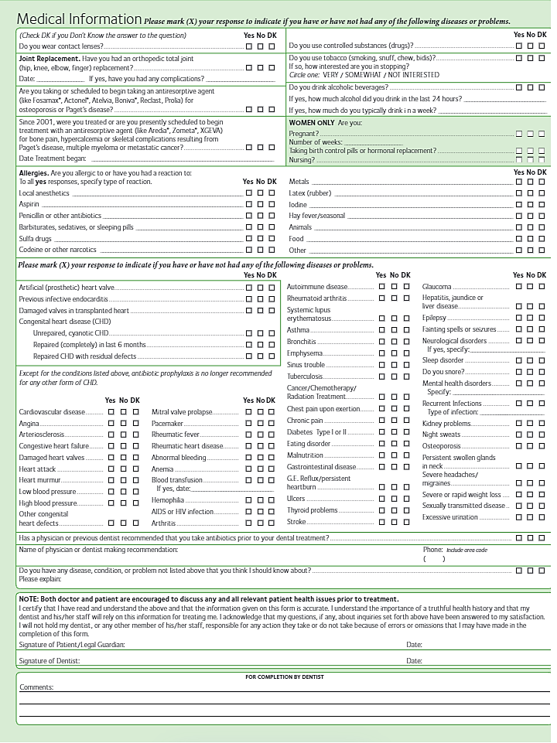
https://pdf.ac/X2r0g

Slide 21
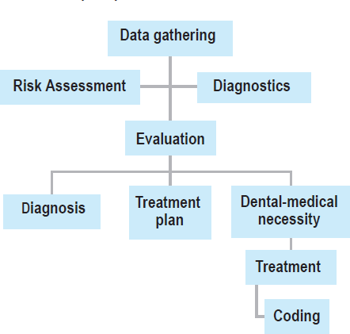
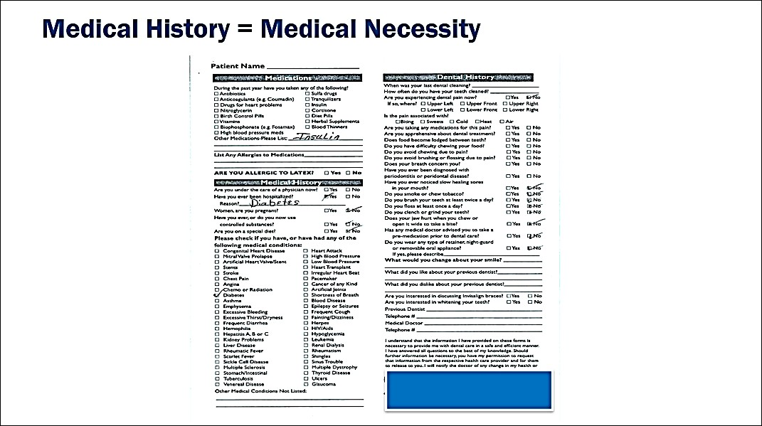
CHANGING THE WAY YOU THINK

Slide 22
GUM DISEASE: OUR #1 CONCERN
Heart Disease: 700 % > risk
Fatal CHD: 50% > risk
Stroke: 300% > risk
Pre-Term Birth: 700% > risk
Diabetes: > risk for uncontrolled glucose
Rheumatoid Arthritis: > risk incidence
Aspiration Pneumonia: > risk for death
Organ transplants: > risk for failure

Slide 23
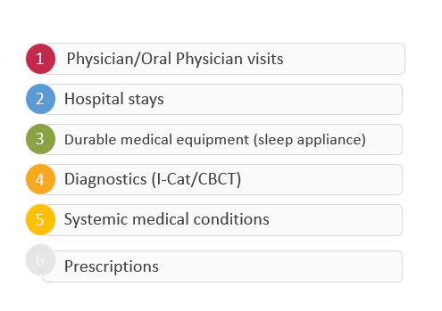

Benefit Breakdown

Slide 24
ICD Code Format
The ICD-10-CM Tabular List contains categories, subcategories and codes, which are combinations of letters, numbers or both.
All categories are 3 characters,
Subcategories are either 4 or 5
Codes may be 3,4,5,6,7 characters: the decimal point is not included in the character count.
Only complete codes are permissible for reporting, and any applicable 7th character must be assigned.
Some codes have a placeholder X which is for updating codes.
Some codes have a character that must always be the 7th character, Accidents are always designated with a 7th character.
https://youtu.be/BsRs6QLEZ6A?

Slide 25
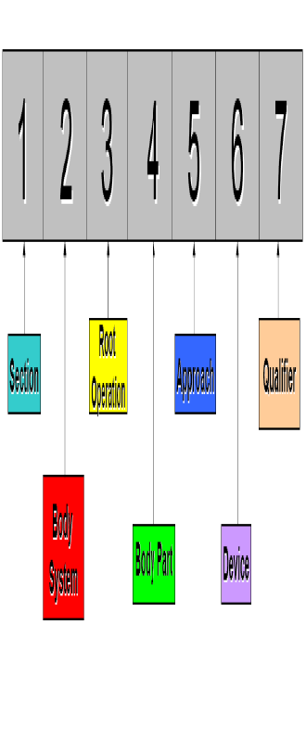
Structure of ICD-10 PCS
Notes:
As you can see, the position designates a specific meaning. This is consistent throughout the entire code set. For any ICD-10-PCS code, the 4th position, for example, always refers to the body part involved in the procedure.

Slide 26
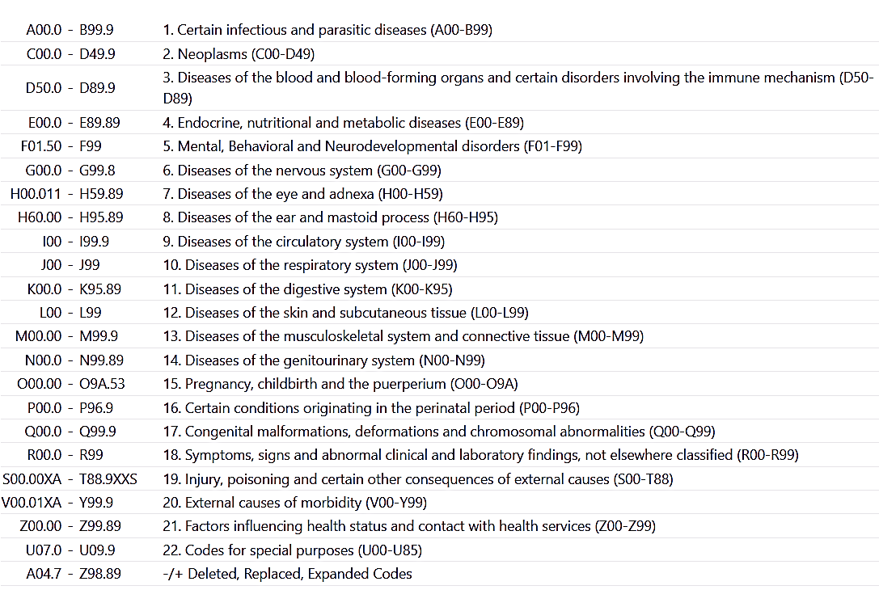
How should a diagnosis be coded when the clinical documentation states: “probable,” “suspected,” “likely,” “questionable,” “possible,” or “still to be ruled out,” indicating uncertainty?
According to ICD-10-CM Guidelines Section II,H, Uncertain Diagnosis, correct coding would be to code the signs, symptoms, and abnormal clinical and lab findings using codes R00-R99 from Chapter 18. These are the only acceptable outpatient codes when a diagnosis has not been firmly established.

Slide 27
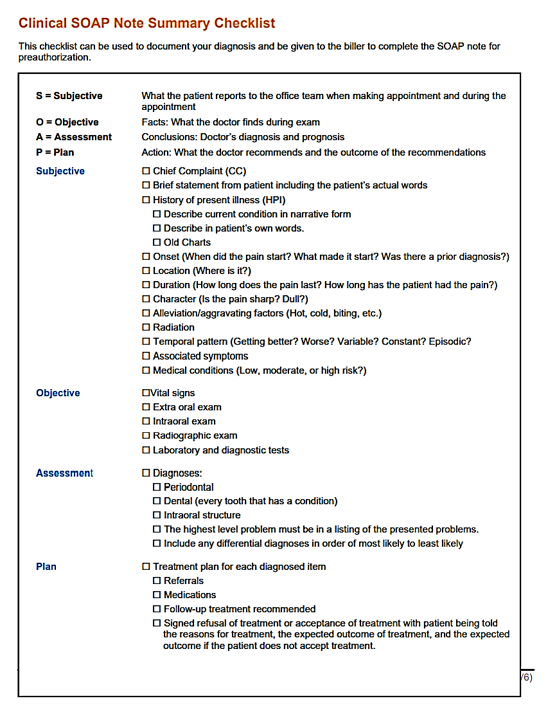
SOAP

Slide 28
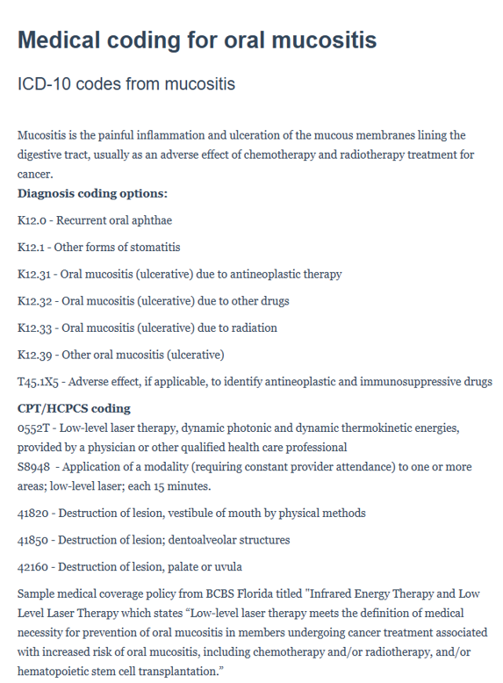

Using a low-level laser?

Slide 29
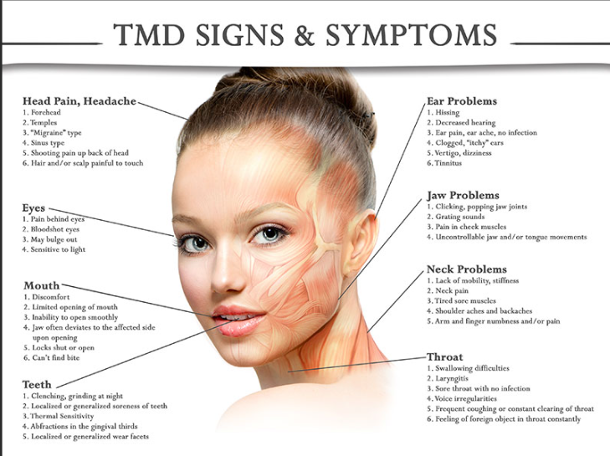
Why Does TMD Need Diagnostic Codes?
What did this patient call your office for?
Why does it matter?
What can you do if she gives you this information on the phone?

Slide 30
Diagnostic Codes for TMD This is Medical Billing since there are laws for each state!
Botox
Migraine
G43.001-G44.1
Musculoskeletal System and Connective Tissue
M06.9-M87.180
Nerve Disorders
Neuralgia is the medical term for nerve pain. The trigeminal nerve is responsible for transmitting nerve signals for sensation from the face to the brain. Trigeminal neuralgia (G50.0) is a disorder in which sharp, sudden, electric-like or stabbing pain shoots across the face, between the forehead, eye region, cheeks, jaws, and gums with simple acts like face washing, brushing teeth, chewing, or speaking. This pain is sudden, intense, and comes and goes with these activities. Trigeminal neuralgia is often a sign of damage to the trigeminal nerve or pressure from nearby blood vessels and muscles.
Trigger Point
G50.0-G52.8
Atypical facial pain (G50.1) elicits pain that may be sharp, but when more closely evaluated, is generally dull and lasting (constant). It may present as aching, burning, crushing, sharp, or even very dull pain and is harder to diagnose, as it may be caused by an underlying medical condition. When the documentation identifies a specific type of trigeminal nerve disorder other than atypical facial pain or trigeminal neuralgia then G50.8 Other disorders of trigeminal nerve should be reported. When the documentation fails to provide details to allow for more specific code selection, then G50.9 Disorder of trigeminal nerve, unspecified would be accurately reported.

Slide 31
Periodontal ICD-Codes Before you can code you will need to know:
Periodontitis (gum disease) is infection and inflammation of the gums, which causes damage to the bone of the teeth. Whereas chronic periodontitis is more common and manifests in adults, aggressive (acute) periodontitis presents during anywhere from childhood to early adulthood. Pericoronitis, which is gum inflammation around partially erupted teeth (teeth which are just beginning to surface), most often occurs around wisdom teeth and is classified in ICD-10-CM under "Periodontitis".
Periodontitis can be localized or generalized:
Localized, involving one or two permanent teeth
Generalized, involving three or more permanent teeth
Periodontitis is further classified into three types:
Slight: Also referred to as "early". Slight bone loss apparent, and the gums are becoming inflammed and separating from the teeth. With loss of soft tissue and bone, pockets (spaces) begin to form, creating an ideal environment for bacteria to thrive.
Moderate: Moderate bone loss apparent, causing the teeth to become loose. Gums begin to recede. Pockets become even larger.
Severe: Severe bone loss renders the teeth to be extremely loose and/or fall out. Pockets may be filled with pus and extra teeth may need to be extracted.

Slide 32
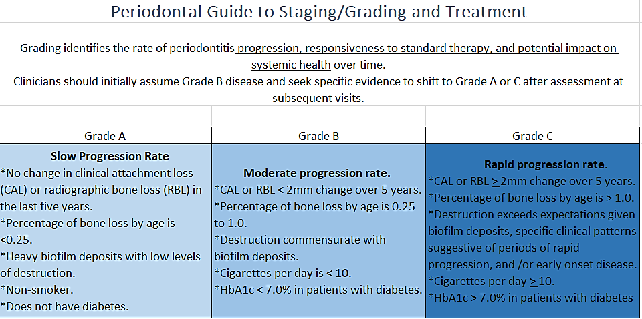

Slide 33
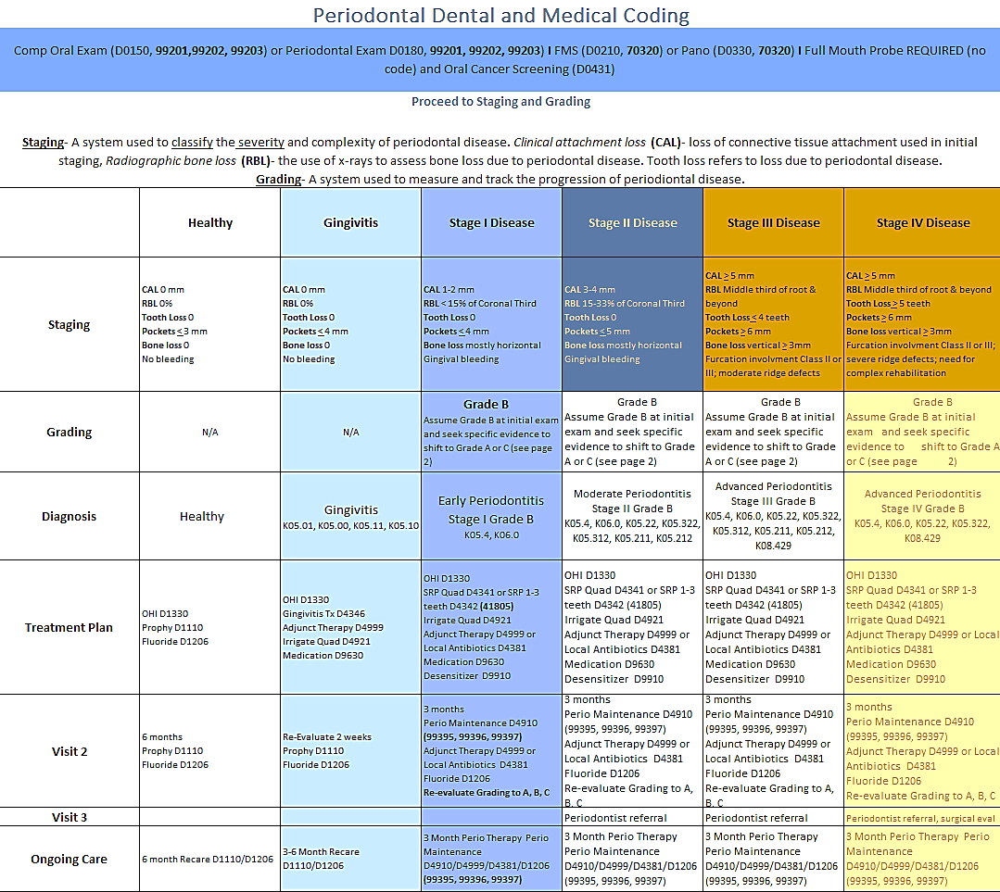

Slide 34
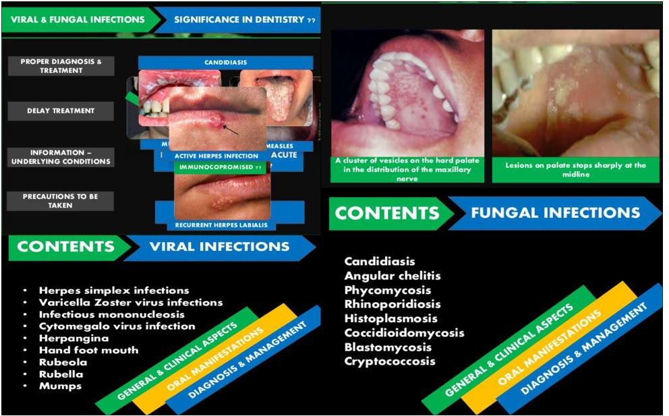
Infections

Slide 35
Infections
The mouth is full of bacteria from foods, saliva, and plaque. Sometimes, these bacteria can enter into a tooth or below the gumline, resulting in a tooth infection or abscess. An abscess is the medical term for a pocket of pus and bacteria that forms within the body’s tissues.
In most cases, tooth infections are easily treatable. However, a person who delays treatment is at risk of developing the following complications:
Osteomyelitis: An infection of the bone surrounding the tooth.
Cavernous sinus thrombosis: An infection of the blood vessels within the sinuses.
Cellulitis: An infection of the skin and fat directly beneath the skin.
Parapharyngeal abscess: An abscess at the back of the mouth.
Sepsis: A serious medical condition in which the immune system severely overreacts to an infection in the blood.
Without treatment, a tooth infection can spread to the face and neck. Severe infections may even reach more distant parts of the body. In some cases, they may become systemic, affecting Multiple tissues and systems throughout the body.
Thrush
Cavities
Periodontal Disease
Gingivitis
Oral Herpes
Herpangina
Syphilis
So much more
Oral Cancer Symptoms:
Persistent Sores: If you have a sore in your mouth that doesn’t heal, seek professional evaluation.
Loose Teeth: Unexpected tooth mobility could be a sign.
Unexplained Bleeding: Any bleeding in the mouth should be investigated.
Lumps or Swelling: Check your neck and face for any unusual masses.
Difficulty Chewing or Swallowing: These issues may indicate underlying problems

Slide 36
The mortality rate from oral cancer is nearly three t...
The mortality rate from oral cancer is nearly three times as high in males as it is in females and nearly twice as high in white and black populations as it is in Hispanic population
Preventing high risk behaviors, that include cigarette, cigar or pipe smoking, use of smokeless tobacco, and excessive use of alcohol are critical in preventing oral cancers
Untreated dental caries affects 2.5 billion people
Severe periodontal disease affects 1 billion people
Complete tooth loss affects 350 million people.
Oral cancer affects 380,000 people
Oral health is linked to mortality in several ways

Slide 37

Examples of ICD-10-CM Specificity Trauma
You need two sets of codes
Jane loved skateboarding but after her last time she may not return.
After her examination we coded V00.131A - Fall from skateboard, initial encounter
We then needed the following information in order to bill medical.
place of occurrence and activity external cause codes, if known (Y92.-, Y93.-)
code to identify:
Airbag injury (W22.1)
Type of street or road (Y92.4-)
Use of cellular telephone and other electronic equipment at the time of the transport accident (Y93.C-)
Her ICD-10
After having our trauma form filled out we were given the following:
Y92.482 - Bike path as the place of occurrence of the external cause
Place of occurrence should be recorded only at the initial encounter for treatment
If this accident happened and she went to emergency room, or had police report we must use that to identify more information. If you are opening the case for Jane and know she needs time to grow before replacing a few missing teeth make sure you document that information to keep the case open to be worked on at that time. That you are providing a temporary appliance to fill the space.
Notes:
Note that the sport and/or specific equipment is mentioned.

Slide 38

When coding for trauma, it’s essential to understand the different scenarios and the corresponding codes. Let’s break it down:
Initial Encounter for Trauma:
  When a patient presents for the first time due to trauma, you’ll use an initial encounter code. This code indicates that the patient is receiving care for the first time related to the trauma.
  For example, if a patient comes to the emergency room after a car accident, you’d use an initial encounter code to describe the visit.
Subsequent Encounters for Trauma:
  Subsequent encounters occur when the patient continues to receive care for the same trauma-related condition.
  These codes indicate that the patient has already received initial treatment and is now returning for follow-up or ongoing care.
  For instance, if the same patient comes back to the hospital for a follow-up appointment after the car accident, you’d use a subsequent encounter code.
Sequela (Late Effects) of Trauma:
  Sequela codes describe the long-term effects or complications resulting from a past injury or trauma.
  When reporting sequela, you’ll usually need to use two codes:
    The first code describes the nature or condition of the sequela.
    The second code specifies the late effect itself.
  For example, if a patient has chronic pain due to an old fracture, you’d use a sequela code to capture both the original injury and its lasting impact.
Remember, accurate coding ensures proper reimbursement and helps track patient outcomes.
If you encounter any complexities, consult official coding guidelines and seek expert advice to ensure precise documentation and coding

Slide 40
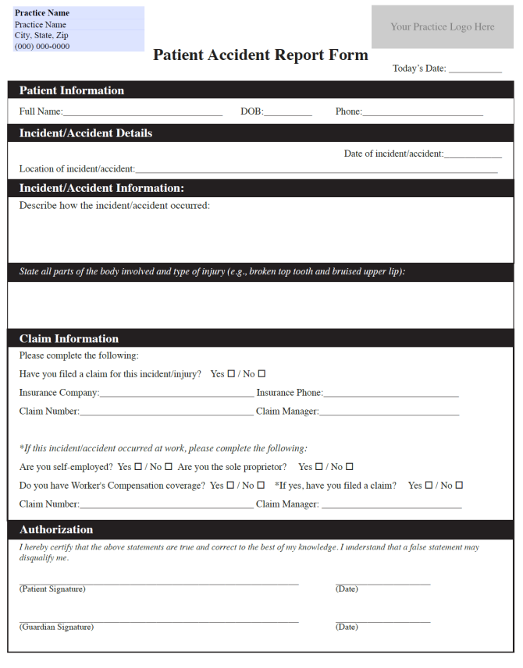
Always protect the office!

Slide 41



Christine Taxin
914-450-2906
ctaxin@links2success.biz
www.links2success.biz
Go to www.dentalmedicalbilling.com
and join our membership program

